Slide 1
BAYLOR COLLEGE OF MEDICINE BIOTECH ACADEMY AT RUSK
Afterschool Activities Parent Information
2022-2023

Slide 2
Athlete code of conduct:
Athletics are a part of the total educational program.
Being an athlete at BCM BAR is a privilege and not a right.
Held to high academic standards- students MUST be passing in ALL classes to participate.
Behavior on and off the field/court should be exemplary as well as in the classroom. Students with behavior issues will not be allowed to participate.

Slide 3
Goals of BCM Biotech Academy at Rusk Athletics and Afterschool Program
Develop the student-athlete
Increase participation in afterschool activities
Improve school spirit and atmosphere
Increase family, community, and school involvement
Recognize and encourage athletic excellence
Teach and promote sportsmanship

Slide 4
Every student MUST have a sports physical to practice and/or play in an afterschool sports activity whether completed by own physician or having one completed at BCM Biotech Academy at Rusk
Sports Physicals will be offered at Rusk on:
Sept. 22: Sports Physical – 2:00PM-4:00PM
Complete all paperwork in packet and turn it into Mrs. Schneider
Cost $2O cash by Tuesday, Sept.20 .
** All sports physicals due on Friday, September 23. If student does not have their sports physical turned in, they will be removed from the sport after the due date.
Sports Physical Required to Participate in Athletics:

Slide 5
Expectations:
Please pick your child on time. In order to ensure the health and well-being of the volunteers and children involved in the program we will not be able to stay late. After 2 times picking up your child late, they will no longer be able to participate in the program. All activities end by 5:00PM-5:15pm, unless changed by coach and you are notified.
Athletes are expected to dress proper attire for daily practices. Bring a snack and water bottle. Coaches will notify students on their expectations.
Students MUST have their sports physical completed by the assigned date. If they do not, they WILL NOT be able to participate in the activity.

Slide 7
7

Slide 9
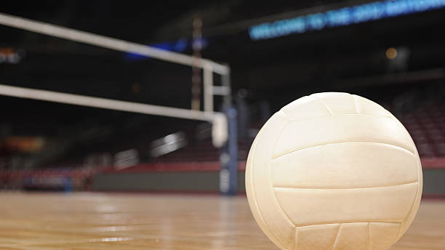
Volleyball
Coach: Mrs. Salazar
Try-Outs:
Thursday, October 6 & Friday, October 7
Days: Tuesday’s and Thursday’s
Time- 4:00-5:15PM
**Bring change of clothing & tennis shoes

Slide 13
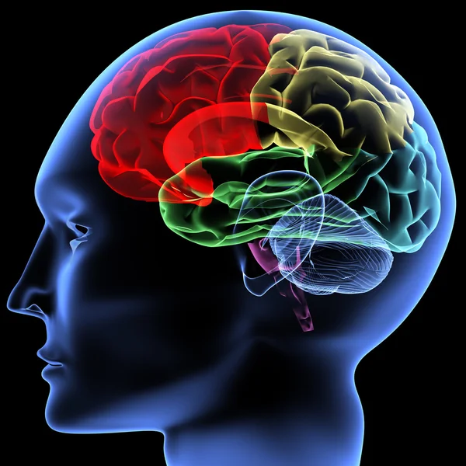
Are you interested in Neuroscience? Are you a leader? You are invited to attend a weekly after school club with neuroscientists from Rice University and the Texas Medical Center leading exciting experiments and activities. Student members may be asked to facilitate these activities for younger students at various school events.
BrainSTEM will meet every Tuesday from 4:00 – 5:15 PM in the Nuc. Participating students must be able to have a ride home after the club is finished and commit to attending each week.
The first BrainSTEM club meeting is tentatively scheduled for September 20. Space is limited to the first 30 students to sign up. To sign up, submit this interest form to Ms. Harris in Room 21A, no later than Monday, September 19th.

